Slide 1

Enhancing handwriting using graphic board Idan Brauner, Sender Hodik
Capstone Project Phase 1
Supervised by Dr. Anat Dahan and Dr. Navit Roth
1

Slide 2
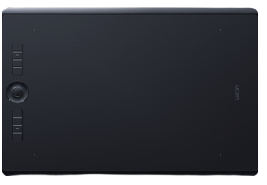
For better handwriting!
We designed a system to provide a convenient and engaging handwriting practice platform with real-time feedback.
2

Slide 3
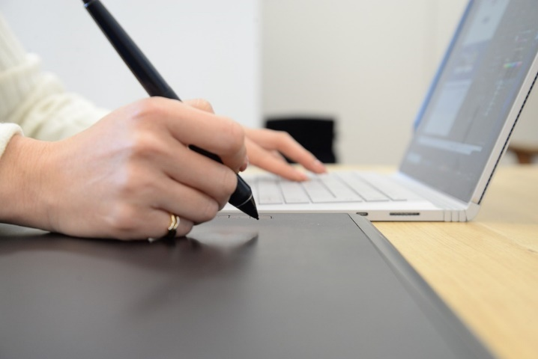
Motivation
The purpose of our project is to help primary school children who are suffering from poor handwriting.
Using a graphic tablet and interactive software, users will experience a friendly interface that focuses on improving handwriting in Hebrew.
It was both our personal experiences with handwriting difficulties from a young age that motivated us to develop this idea.
Graphic tablet
used in learning environment
3

Slide 4
Our system includes
01
02
03
04
User menegment system
Letter Practice
Using our system, users can manage multiple profiles, and each profile can access practices.
Rewriting letters can assure that they are written correctly in size and orientation.
Organization practice
Progress Tracking
Whenever writing departs from the line, it is evaluated in real time. also it will be checked to ensure that it is completed in segments as instructed.
Users are able to view their own profiles to track their practices.
4

Slide 5
The importance of improving handwriting at an early age
Improving handwriting at an early age can have a number of benefits for children. Here are a few reasons why it is important:
Handwriting is an important skill for academic success.
Handwriting can improve fine motor skills as using small muscles in the hands and fingers to control a writing instrument.
Handwriting can support language development.
Handwriting can boost self-esteem and confidence.
Overall, improving handwriting is an important skill that can have a positive impact on children's academic and personal development.
5

Slide 6
Dysgraphia
Dysgraphia is a neurological condition that causes someone to have difficulty putting their thoughts into written form for their age and ability to think, These are some aspects they may be struggling with:
Letter formation and/or legibility.
Letter size and spacing.
Spelling.
Fine motor coordination.
Rate or speed of writing.
Grammar.
Composition
The following are some examples of how dysgraphia can present itself
Difficulties writing in a straight line.
Difficulties with holding and controlling a writing tool.
Writing letters in reverse.
Having trouble recalling how letters are formed.
Having trouble knowing when to use lower or upper-case letters.
Struggling to form written sentences with correct grammar and punctuation.
Omitting words from sentences.
Incorrectly ordering words in sentences.
Using verbs and pronouns incorrectly.
Through occupational therapy,
these symptoms can be alleviated
6

Slide 7
Handwriting parameters
Handwriting refers to the style in which a person writes using a pen or pencil. Some of the parameters that can be used to describe handwriting include:
Slant: Handwriting can be upright (with little or no slant to the right or left) or slanted (leaning to the right or left).
Size: Handwriting can be large or small in size.
Pressure: The pressure with which a person writes can affect the appearance of the handwriting. Light pressure can result in thin, faint lines, while heavy pressure can result in thicker, darker lines.
7

Slide 8

Handwriting parameters
Spacing: The space between letters and words can vary in handwriting. Some people may have closely spaced handwriting, while others may have more widely spaced handwriting.
Connections: Some letters may be connected in handwriting, while others may be written separately.
Fluidity: Handwriting can be smooth and fluid or choppy and jerky.
Legibility: Handwriting that is easy to read is considered to be legible, while handwriting that is difficult to read is considered to be illegible.
8

Slide 9
Handwriting parameters
Handwriting speed refers to the rate at which a person is able to write by hand. This can be measured in words per minute (wpm) or in characters per minute (cpm). Factors that can affect handwriting speed include the individual's level of proficiency in writing, their writing implement (pen, pencil, etc.)
Handwriting orientation refers to the direction in which a person writes. The orientation includes accuracy to maintain the writing between the specific border of the line and from where to start the writing of a letter and where to end it.
9
Notes:
Researchers have found a link between organizational skills and handwriting performance, which is an important point to note. In most Western countries, people are taught to write from left to right, starting at the top of the page and moving down. This is known as a left-to-right orientation. However, some people may have a different writing orientation, such as right-to-left or top-to-bottom.

Slide 10
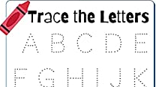
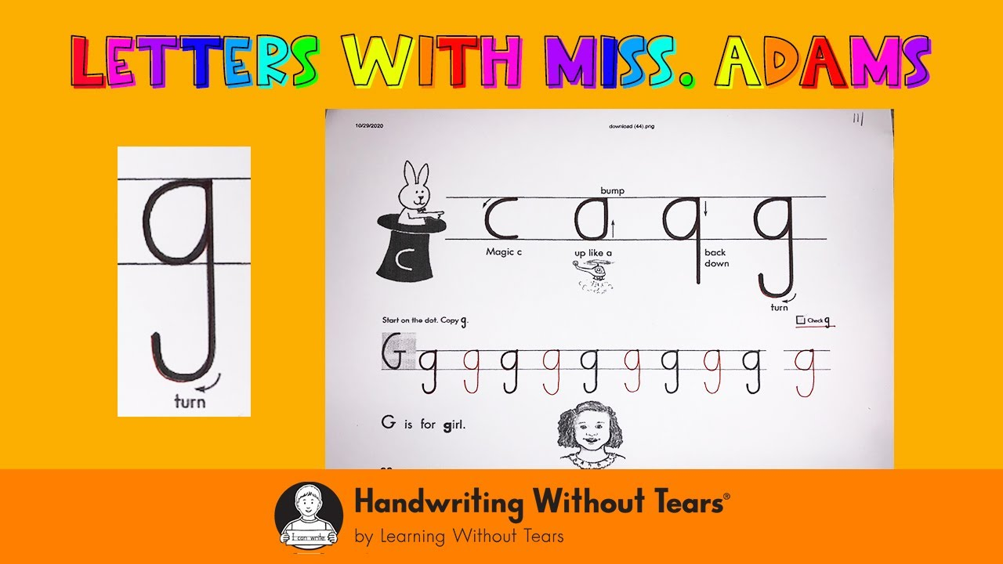
Related Work
Handwriting tracing worksheet
Handwriting without tears
sheet of paper with lines or shapes on it that a person can use to practice writing letters or numbers.
a multi-sensory approach, incorporating visual, tactile, and kinesthetic elements to help children learn how to form letters correctly. Based on English language
10

Slide 11

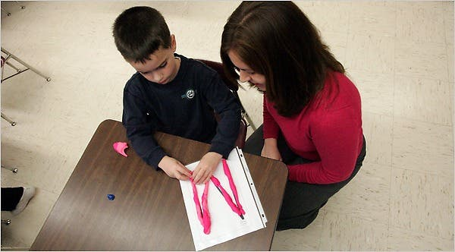
Occupational Therapy Intervention in Handwriting
Occupational therapy intervention for handwriting may include a variety of techniques, depending on the specific needs of the individual.
An occupational therapist may assess the individual's fine motor skills, hand strength, and dexterity, as well as visual-perceptual skills and visual-motor integration.
Interventions may include exercises to improve hand strength and dexterity, such as using putty or squeezing a hand gripper.
An occupational therapist may also teach the individual proper pencil grip and letter formation techniques.
https://www.nytimes.com/2010/02/25/fashion/25Therapy.html
11

Slide 12
Expected Achievement's
Improving handwriting skills
User experience
Interactive system
Providing users with a seamless and intuitive interface for entering and interacting with handwritten text and symbols
This may involve providing feedback and guidance on proper handwriting.
ability to adapt to the specific needs of each user
12

Slide 13
Graphic tablets
A graphic tablet is an input device that allows a user to draw, paint, and write on a computer screen or digital canvas.
The most common type of graphic tablet is the Wacom tablet, which uses a stylus or pen to interact with the tablet surface.
They can be connected to a computer via USB or Bluetooth and can access a wide range of software, including Adobe Photoshop, Illustrator, and web-based libraries.
13

Slide 14
Graphic tablets - Wacom Intuos Pro
The Wacom Intuos Pro version can attach a paper that is a variant of the regular Wacom Intuos Pro graphic tablet that comes with a special paper clip, which allows the user to draw on paper and have their work digitized in real time.
This allows the user to draw on paper as they normally would, and have their work automatically converted into a digital format and saved to their computer.
14

Slide 15
Wacom Intuos Pro
15

Slide 16

The Main Algorithm: Handwriting practices
16

Slide 17
Graphic libraries
Rather than the cumbersome treatment process that exists today, we are interested in creating a visual interface that makes the treatment process more enjoyable.
Graphic libraries are able to illustrate graphics on the screen in an intuitive and comfortable manner.
Among the programs, there is a p5.js library, which is described as follows: “p5.js is a JavaScript library for creative coding, with a focus on making coding accessible and inclusive for artists, designers, educators, beginners, and anyone else!”
17

Slide 18
Graphic libraries
This p5.js library has a unique draw function that allows the drawing to run continuously and be dynamic. Therefore, additional illustrations can be added and react in real time to events.
The p5.js library captures the coordinates of the stylus and converts them into digital drawings on the computer screen.
Additionally, the p5.js library can be used to apply various effects and transformations to the digital drawings, such as color, size, and rotation. This allows for a more natural and intuitive drawing experience compared to using a mouse or trackpad.
18

Slide 19
Letter Practice
The user can replace the manual method of tracking pages this option, the user will be able to select a specific letter from the Hebrew alphabet (“print” letters, endings included).
Following the selection, of one of the letters, the user will see a page with lines including that letter on it.
As part of the practice - the user must complete the letter in its identical form and order, which can be done by rewriting according to its size and orientation.
19

Slide 20

Letter Practice
The user will have to follow the marked letters in the correct order.
real-time feedback will be given for his actions, including selecting the letter, directional tests, and letter marking (based on comparison of the input coordinates with the letters' positions on the screen).
A feedback example is alerting the user when he selects a letter to rewrite but it's not in the correct order.
20

Slide 21
Organization practice
Handwriting organization practice is based on the concept that a patient should maintain the correct order on the page.
In our case - the Hebrew language - we write from the top to the bottom.
As a part of the practice, the page will be divided into segments according to the user's decision when the parameter is the gap between two writing points.
A user input parameter will also determine the minimum percentage of writing in a line before moving on.
21

Slide 22
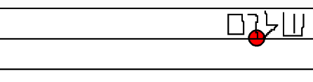
Organization practice
Since the rate of writing is an important measure, we will use a timer during practice to measure the rate of writing, so the user can see and control his progress.
22

Slide 23
System design and architecture
23

Slide 24
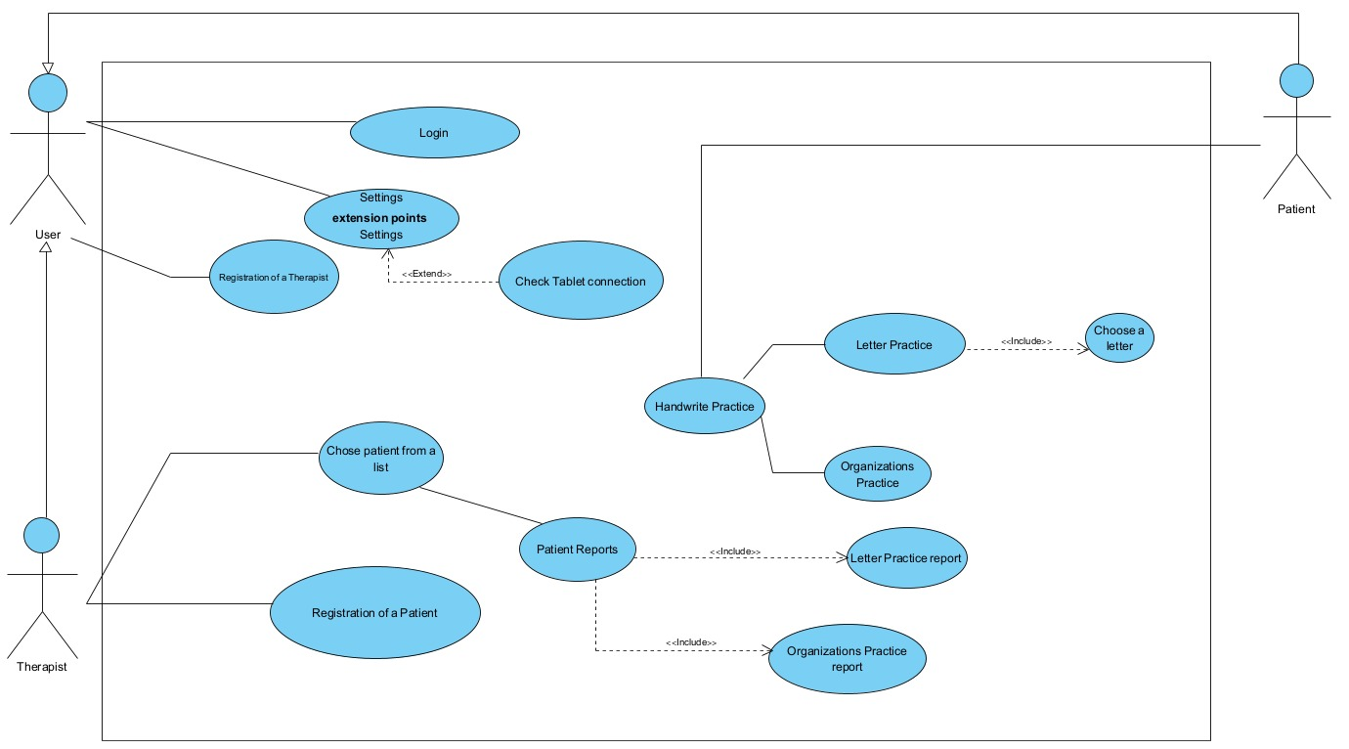
Use Case
24

Slide 25
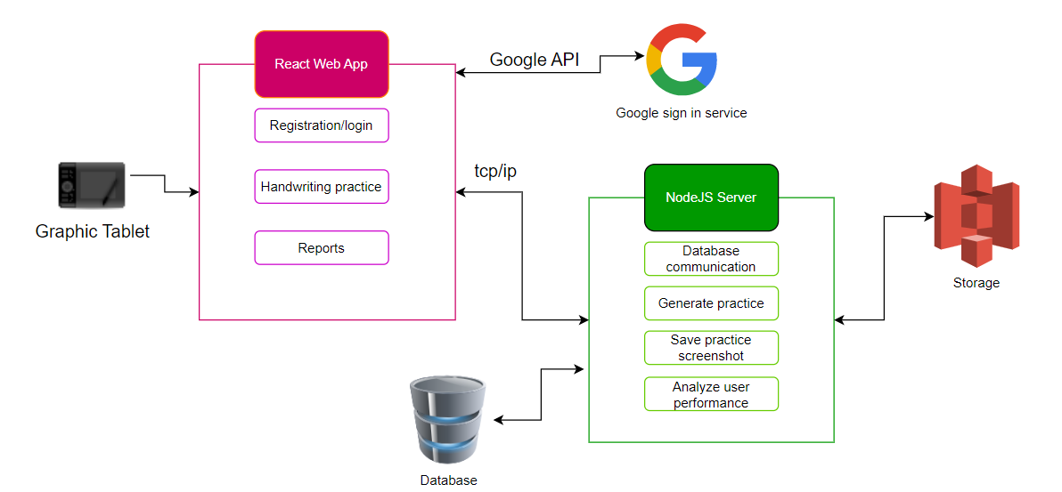
Project architecture
25

Slide 26
Evaluation and Verification Plan
26

Slide 27
Evaluation
User feedback
Tracking
Efficiently
Each profile in the system will have its own indicators, which will appear on dedicated pages.
Stable and real-time response system
Users can give feedback and provide an authentic evaluation of their experience
27

Slide 28
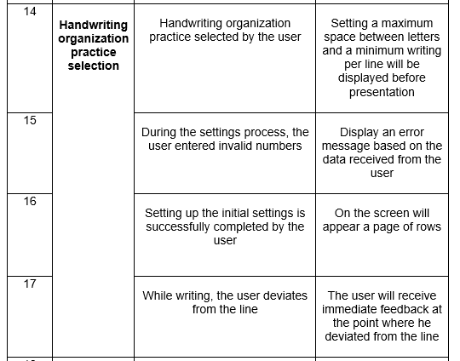
Verification
The diagrams we characterized and the list of requirements we wrote will help us verify the reliability of our final product.
A table of tests will be created as we follow them, and unit tests will be performed for each part as we move into the second phase of the project.
As part of the test plan, we will also perform end-to-end testing for all the system's processes.
For the implementation of the tests, we will use the Jest framework for JavaScript app testing
Subject
Headline
Expected result
28

Slide 29
Thanks for listening ☺
29

